Slide 1


BECAUSE FREEDOM CAN’T PROTECT ITSELF.
Impact Report FY2014-2015

Slide 2
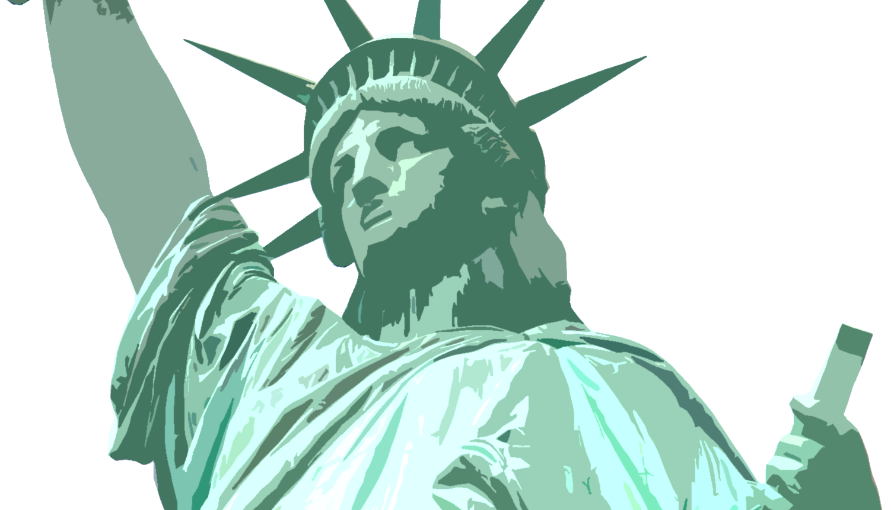
The ACLU of South Carolina is dedicated to preserving the civil liberties enshrined in the U.S. Constitution and Bill of Rights. Through communications, lobbying and litigation, the ACLU of South Carolina works to preserve and enhance the rights of all citizens of South Carolina. Foremost among these rights are freedom of speech and religion, the right to equal treatment under law, and the right to privacy.

Slide 3
ACLU of South Carolina Team
Board of Directors
Robin Garrell, President
John Leiter, Vice President
Marcy Hayden, Secretary
Heather Cairns, Treasurer
Millicent Brown
David Cohen
Connie Sage Conner
William Griffith
Glen Halva-Neubauer
Scott Jorgensen
Stefanie Keen
Susan Kuo
Romina McCandless
James Morton
Katherine Myers
Edgar Michael Pinilla
Ivan Segura
Anne Tromsness
Edith Williams
Staff
Victoria Middleton, Executive Director
Susan Dunn, Legal Director
Jessica McFadden, Office Manager

Slide 4

First Amendment

Slide 5
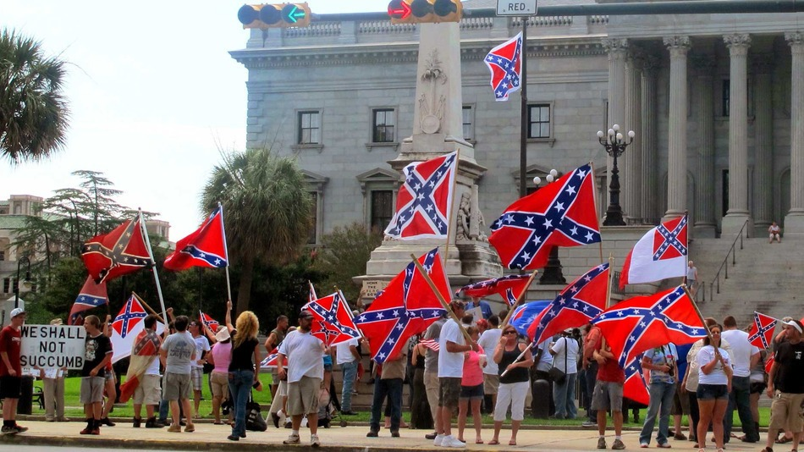
Defending freedoms of the first amendment
We called for and applauded the removal of the Confederate Flag on Statehouse grounds as a matter of state-sanctioned speech,
while we also defended the rights of Secessionists to protest its removal.
Notes:
We called for and applauded the removal of the Confederate Flag on Statehouse grounds as a matter of state-sanctioned speech, while we also defended the rights of Secessionists to protest its removal.

Slide 6
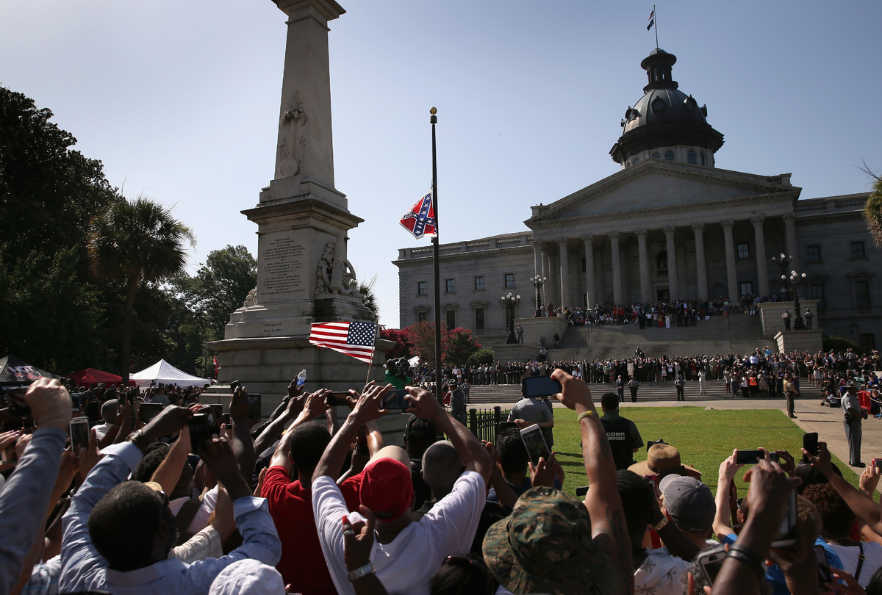
July 10, 2015
Columbia, SC
ACLU of South Carolina welcomes the South Carolina legislature’s historic decision to remove the Confederate flag from the Statehouse grounds. At issue was not an individual’s free speech rights but government speech that was divisive rather than inclusive, deeply offensive and indicative of racial hatred and injustice to many in our state and beyond. At the same time, we know that this action is not enough to eradicate structural and institutional racism in our state, and we will redouble our efforts to ensure equal protection and treatment for all people in South Carolina.
-ACLU of South Carolina Statement
Notes:
July 10, 2015
Columbia, SC
ACLU of South Carolina welcomes the South Carolina legislature’s historic decision to remove the Confederate flag from the Statehouse grounds. At issue was not an individual’s free speech rights but government speech that was divisive rather than inclusive, deeply offensive and indicative of racial hatred and injustice to many in our state and beyond. At the same time, we know that this action is not enough to eradicate structural and institutional racism in our state, and we will redouble our efforts to ensure equal protection and treatment for all people in South Carolina.
-ACLU of South Carolina Statement

Slide 7
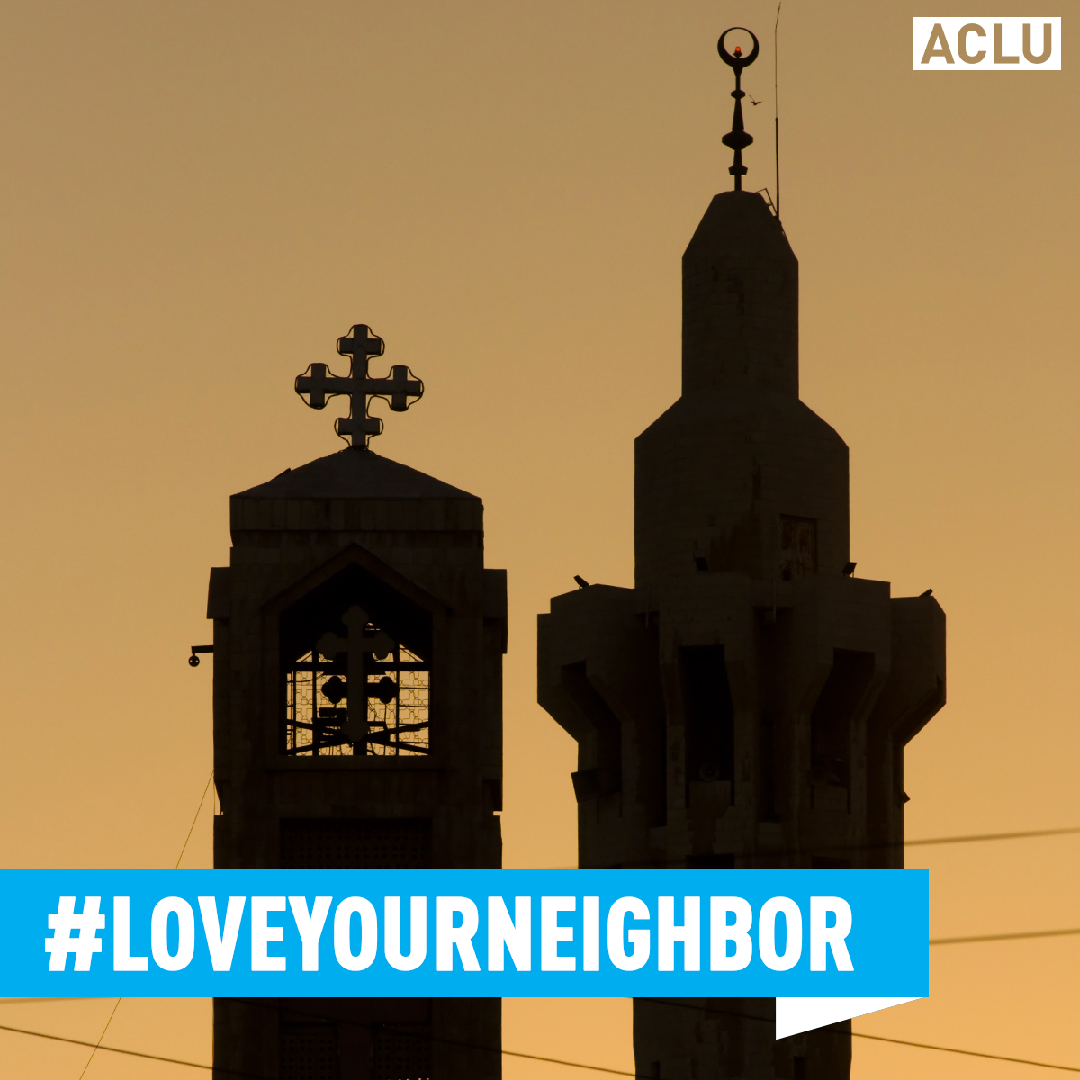
Defending freedoms of the first amendment
We testified against Sharia law ban in the House as targeting Muslims:
H 3521
A Bill to amend the code of laws … to prevent a court or other enforcement authority from enforcing foreign law including, but not limited to, Sharia law, in this state.

Slide 8
Defending fReedoms of the first amendment
[T]his bill is explicitly anti-Muslim, and at least one court in another state has overturned a law that explicitly mentioned Sharia because this unconstitutionally signaled disfavor for Muslims.”
- ACLU of South Carolina Testimony
“H. 3521 represents an attack on the separation of powers, an unwarranted mistrust of the state judiciary, and an unnecessary interference in the function of South Carolina’s legal system.
Notes:
H. 3521 represents an attack on the separation of powers, an unwarranted mistrust of the state judiciary, and an unnecessary interference in the function of South Carolina’s legal system.
[T]his bill is explicitly anti-Muslim, and at least one court in another state has overturned a law that explicitly mentioned Sharia because this unconstitutionally signaled disfavor for Muslims.
- ACLU of South Carolina Testimony

Slide 9
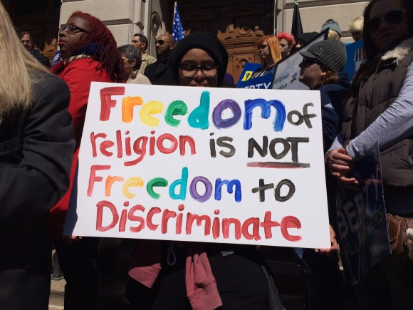
RFRA

Slide 10


We scored a big win against discrimination this year!

Slide 11
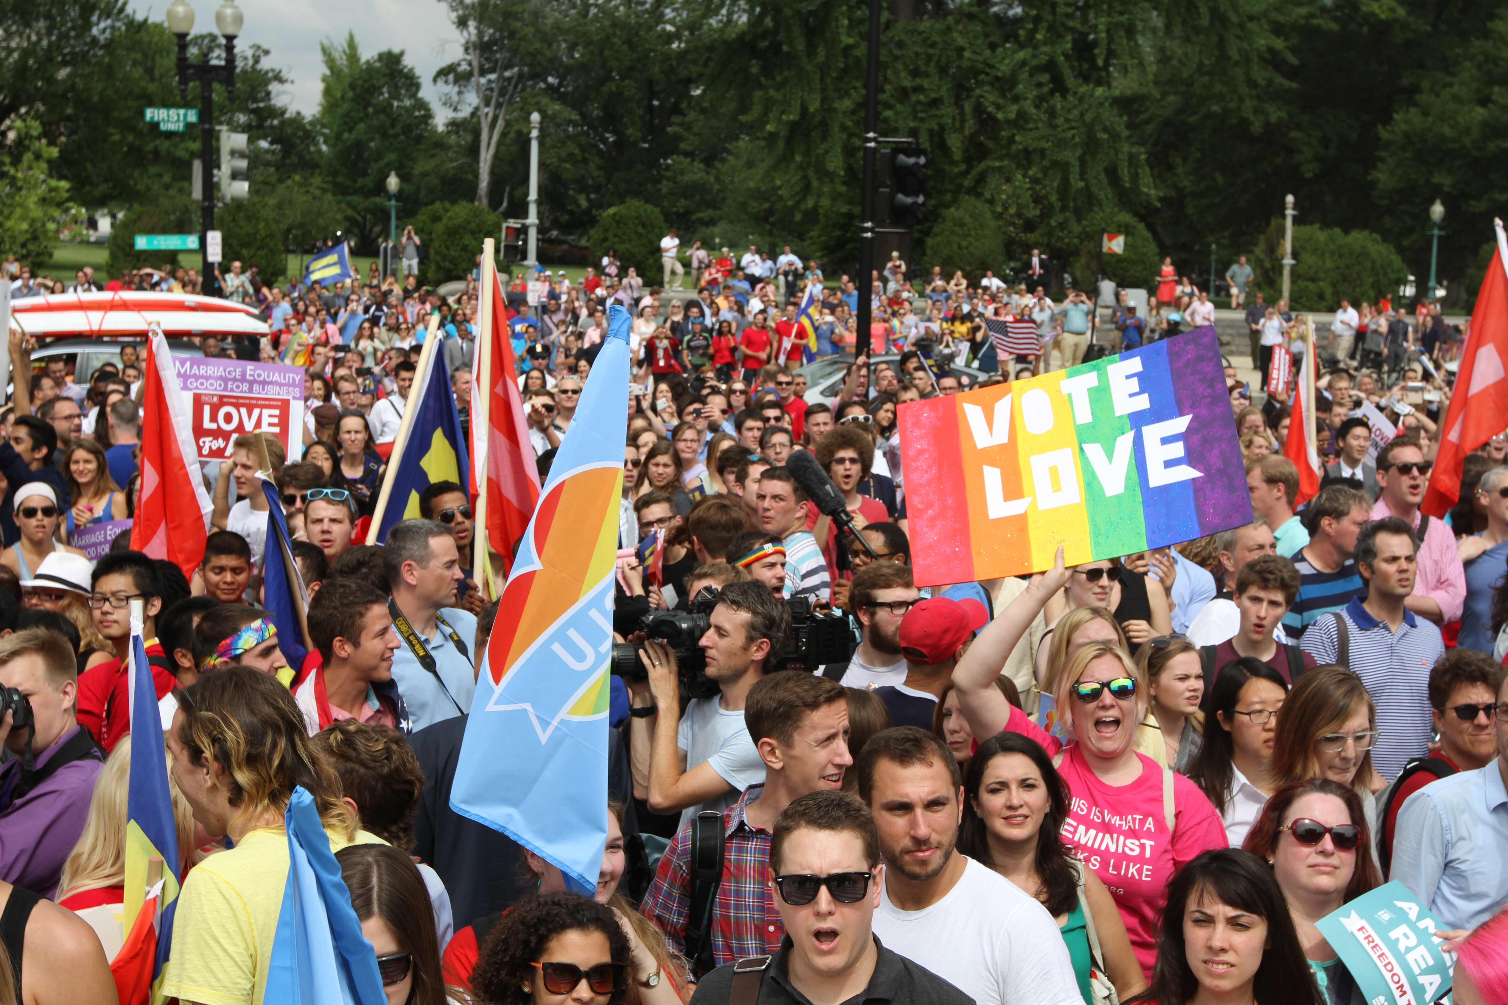
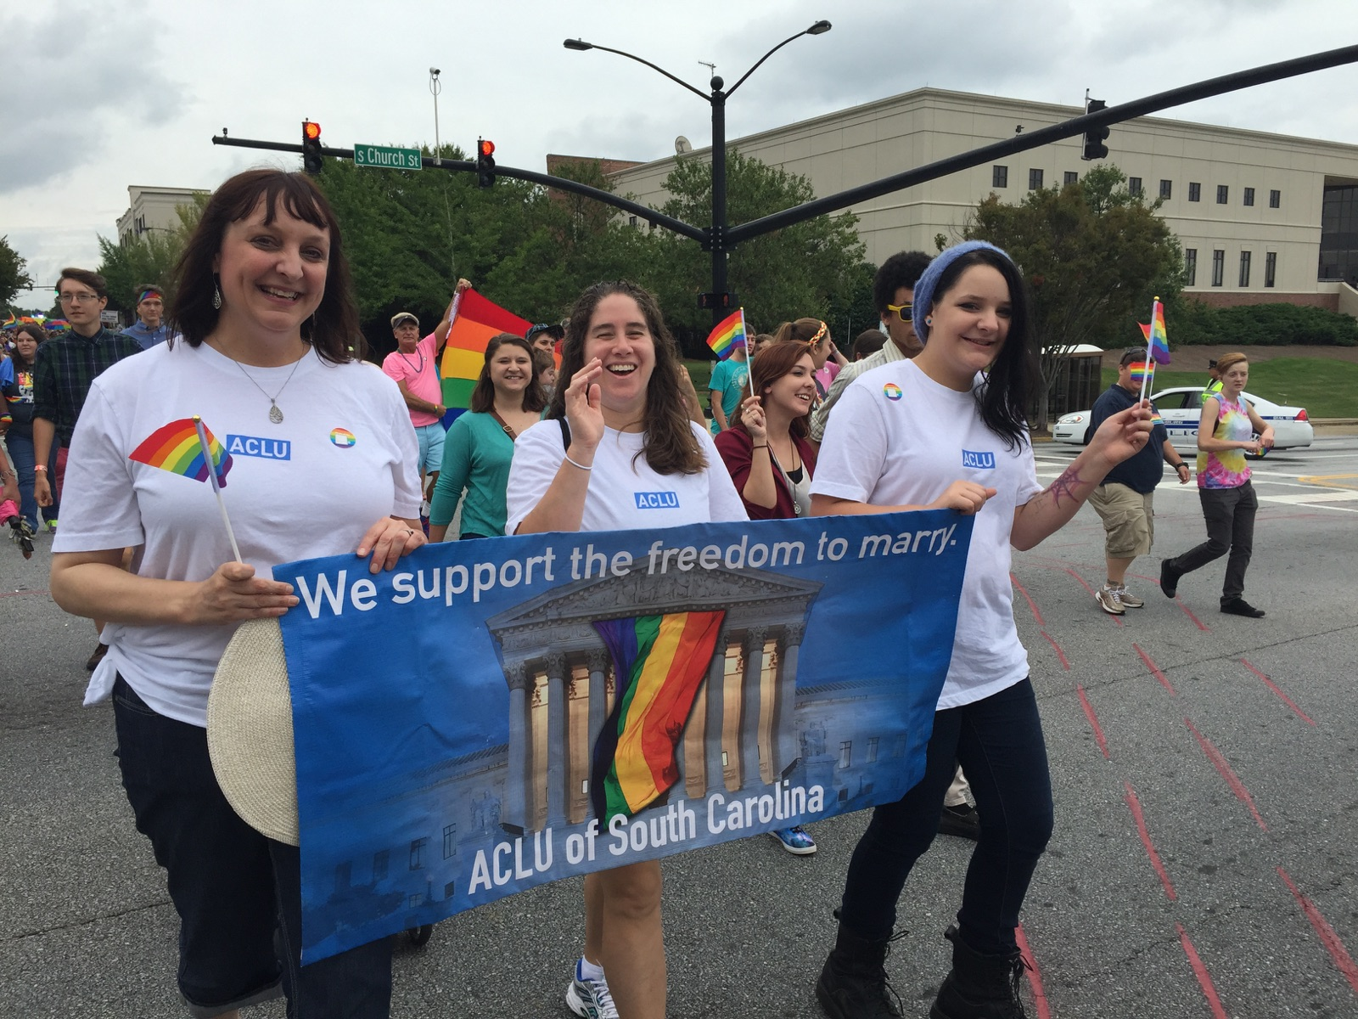
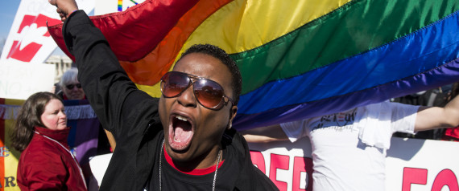
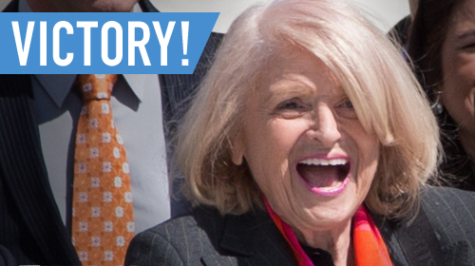
Freedom to marry
1970 – ACLU files the first right-to-marry lawsuit in the country.
2004 – ACLU files lawsuits against 6 states.
2008 – Marriage equality comes to California & Connecticut.
2013 – The U.S. Supreme Court strikes down the Defense of Marriage Act.

Slide 12
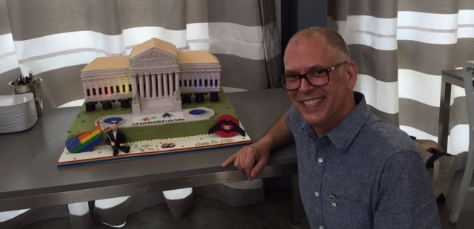
Freedom to marry
The U.S. Supreme Court ruled on June 26 that all remaining state marriage bans were unconstitutional in the case of Obergefell v. Hodges. The ACLU successfully represented Jim Obergefell (left) and his husband, the late John Arthur, among other plaintiffs.

Slide 13
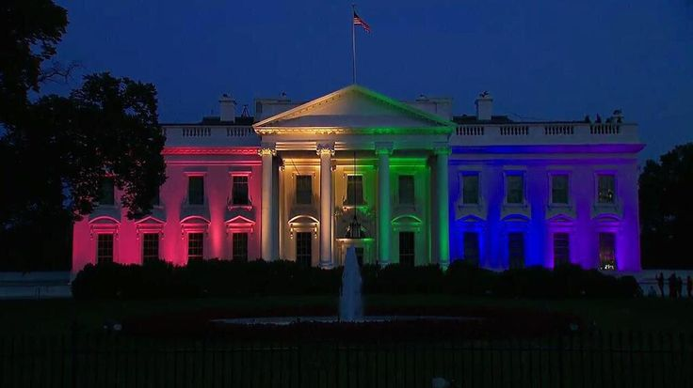
June 26, 2015

Slide 14
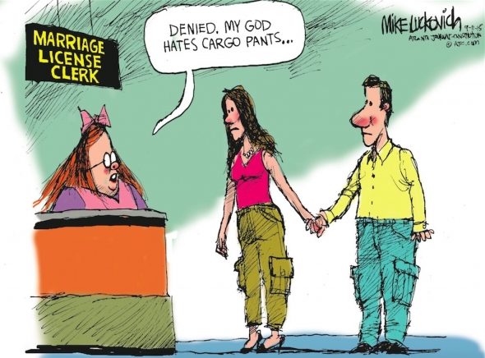
But we also saw new threats arise
OPPOSE LEGISLATION:
allowing a judge or clerk to refuse a marriage license based on a religious objection;
preventing sanctioning of those individuals who refuse to perform services for a same-sex marriage;
prohibiting recognition and benefits to same-sex couples.

Slide 15

Religious Freedom Refusal Act
SUPPORT MEASURES TO:
amend a section of the code regarding state filing status to include legal same-sex marriages to ensure that terms are not gender-specific & exclusionary;
allow the names of both parents in a same-sex marriage to appear on their children’s birth certificate.

Slide 16
the attacks on the South Carolina LGBTQ community keep coming:
Amendment to the U.S. Constitution to define marriage as the union of a man and a woman.
Prohibit Department of Corrections from using state funds to continue hormonal therapy or sexual reassignment surgery.
Void decisions of the United States Supreme Court if the State & its legislators disagree with SCOTUS rulings.
Prohibit the use of state funds for issuing same-sex marriage licenses.
Legislation related to the institution of marriage may also be considered by each body of the General Assembly prior to adjournment.

Slide 17

We support these inclusive measures in south Carolina:
“Uniform Antidiscrimination Act” definition would broaden to prohibit discrimination based on sexual orientation.
“The Workplace Fairness Act” would protect LBGTQ workers in South Carolina from being discriminated against because of who you love.

Slide 18
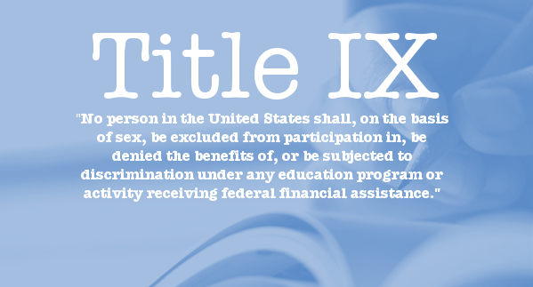
LGBT Rights in Schools
We opposed, and will continue to oppose, efforts of colleges and universities use of their religious affiliations as an excuse to discriminate against the LGBT community.
Schools around the nation, including at least four in South Carolina, have been granted a waiver of “provisions of Title IX to the extent application of those provisions would not be consistent with the Convention’s religious tenets regarding marriage, sex outside of marriage, sexual orientation, gender identity, pregnancy, and abortion.”
Notes:
Anderson University, Charleston Southern University, North Greenville University, Southern Wesleyan University
http://thecolu.mn/21270/dozens-christian-schools-win-title-ix-waivers-ban-lgbt-students

Slide 19
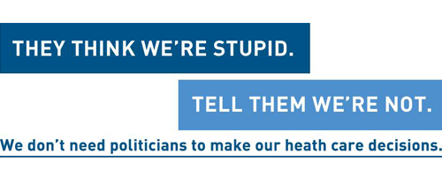
We defend a woman’s liberty to make her own personal medical decisions

Slide 20
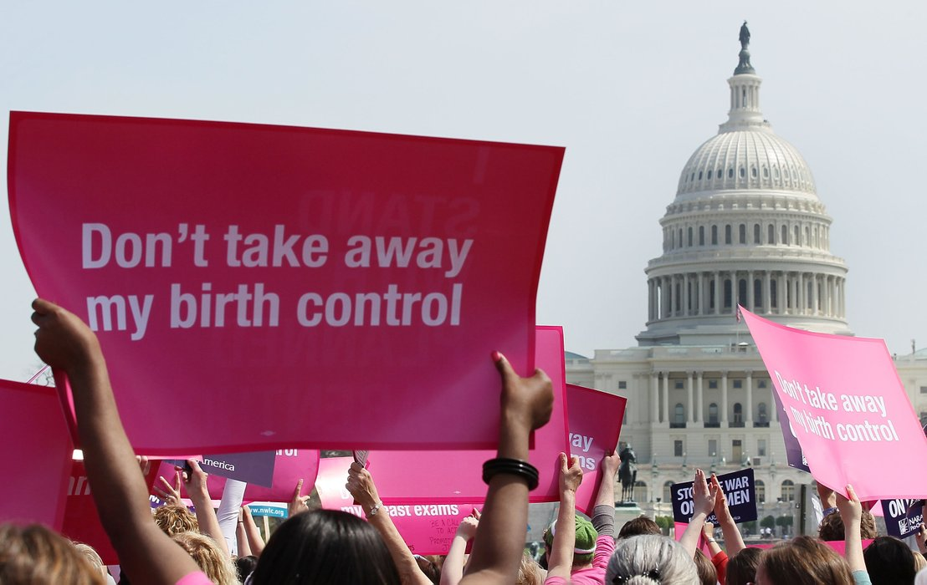
Reproductive Freedom

Slide 21
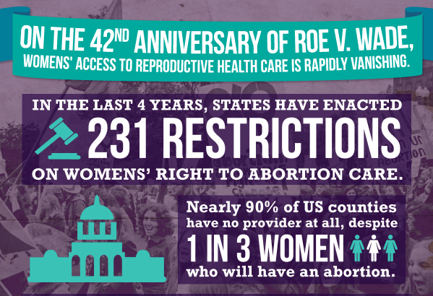

Slide 22
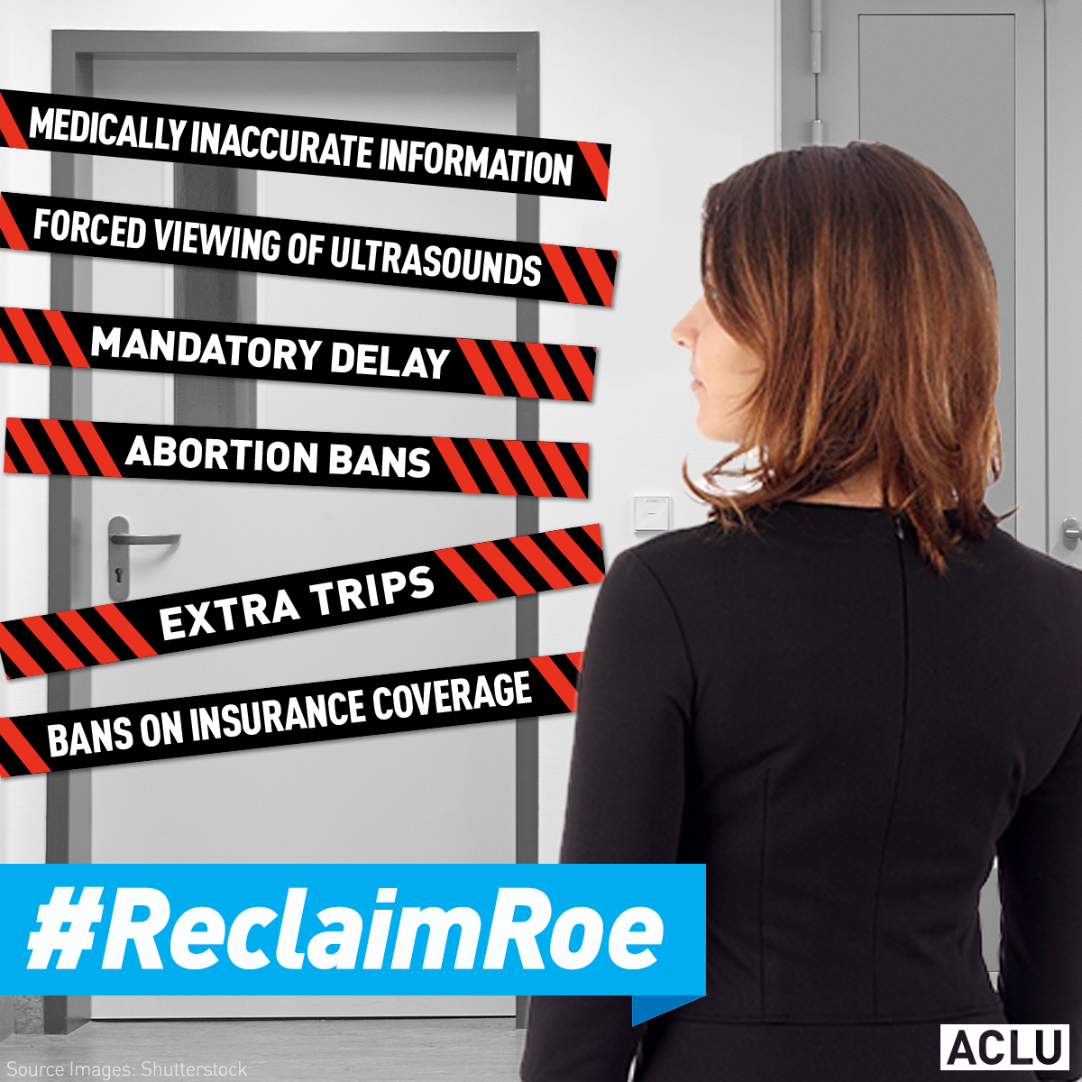
Legislative action
We testified against H. 3114, S. 25, S. 28, S. 96 & S. 130 which would ban abortions at 20 weeks. We were and remain leaders in the fight against this and similar bills:
S. 34 & S. 122 – bans abortion-inducing drugs & complicates procedures for acquiring drugs under special circumstances.
S. 96 & S. 92 – mandates ultrasound & bans abortions if fetal heartbeat is detected.
S. 122 – prohibits employers from being able to contribute to abortion services in state insurance plans.
S. 129, S. 719 & H. 4093 – establish personhood at fertilization.

Slide 23

Defunding clinics
The S.C. state legislature continued the nationwide attacks on Planned Parenthood by requesting investigations into the operations of the organization, in the hopes of uncovering unethical or illegal practices by the group.
We wrote a letter to the Legislative Audit Council denouncing the inquests as politically-motivated and wholly unnecessary.

Slide 24
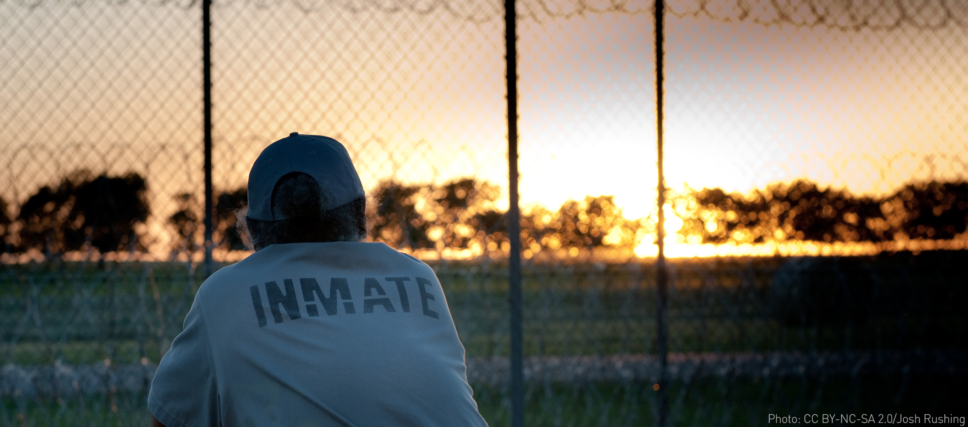
Reducing mass incarceration
Oppose new mandatory minimums and 3-strikes laws.
Support diversion of non-violent offenders into alternatives to incarceration.
Seek opportunities to improve prison conditions and health of inmates by monitoring intake complaints from prisoners.
Notes:
Oppose new mandatory minimums and 3-strikes laws.
Support diversion of non-violent offenders into alternatives to incarceration.
Seek opportunities to improve prison conditions and health of inmates by monitoring intake complaints from prisoners.

Slide 25
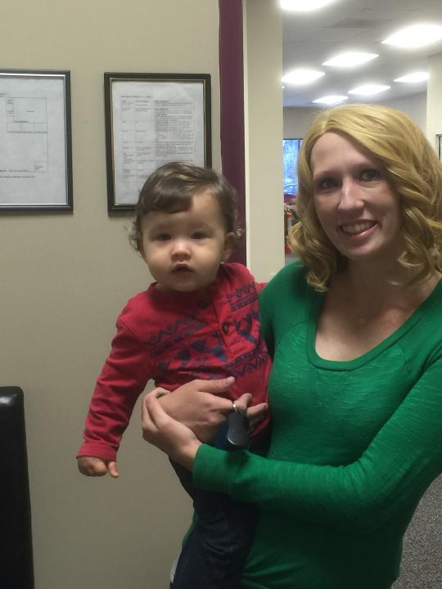
A Mother’s Rights
LJ is a young mother whose son was removed because she was on methadone maintenance.
We presented expert affidavits which resulted in the Court finding that DSS was wrong to insist LJ withdraw from methadone treatment in order to regain custody.
She is now reunited with her son and is also attending technical college.

Slide 26
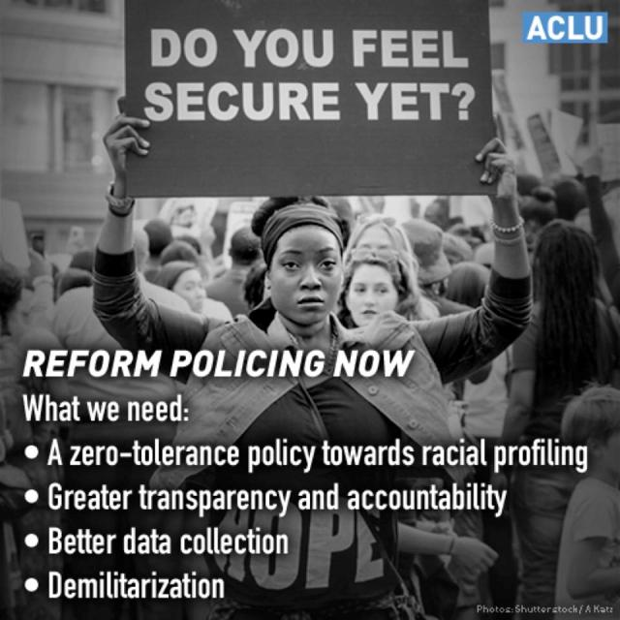
Policing the Police
We testified extensively on the use of police-worn body cameras:
“Police on-body cameras [have the] potential to serve as a check against the abuse of power by police officers and against false or exaggerated complaints against officers. Encounters between police officers and the public often result in radically divergent reports. Cameras have the potential to be a win-win, helping protect the public against police misconduct, and at the same time helping protect police against unfounded accusations of abuse.”
-ACLU of South Carolina testimony

Slide 27

Policing the police
And we testified for citizens’ right to record law enforcement:
“S.647 is drafted to protect citizens from law enforcement restriction of photography. We applaud the Senate for addressing this important subject. The filming of the death of Walter Scott in North Charleston by a bystander highlights how important such recording can be to documenting and preserving the truth.”
- ACLU of South Carolina testimony

Slide 28
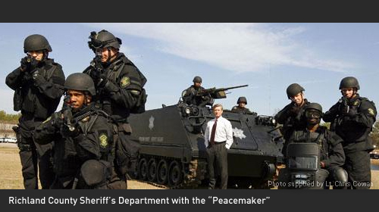
Policing the Police
“… Aggressive policing of low-level offenses can erode community safety by increasing adversarial relationships and distrust.”
ACLU of SC Op-Ed
Statehouse Report, 09/03/2015

Slide 29
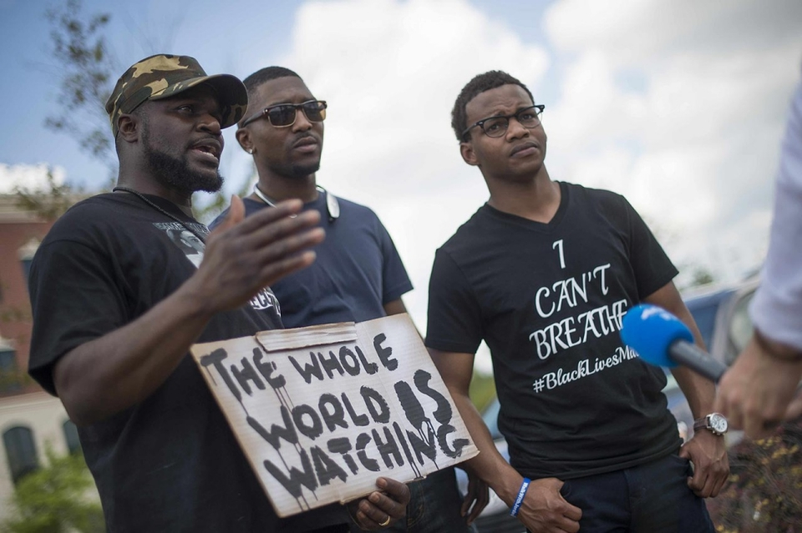
“The ACLU of South Carolina urges state and federal officials to conduct a thorough investigation into the practices of the North Charleston Police Department following the fatal shooting … of Walter Scott. Video released … raises disturbing questions about excessive use of force,” ACLU of S.C. Executive Director Victoria Middleton said.
ACLU of SC quote
The State,
04/08/2015
Photo: al Jazeera America

Slide 30
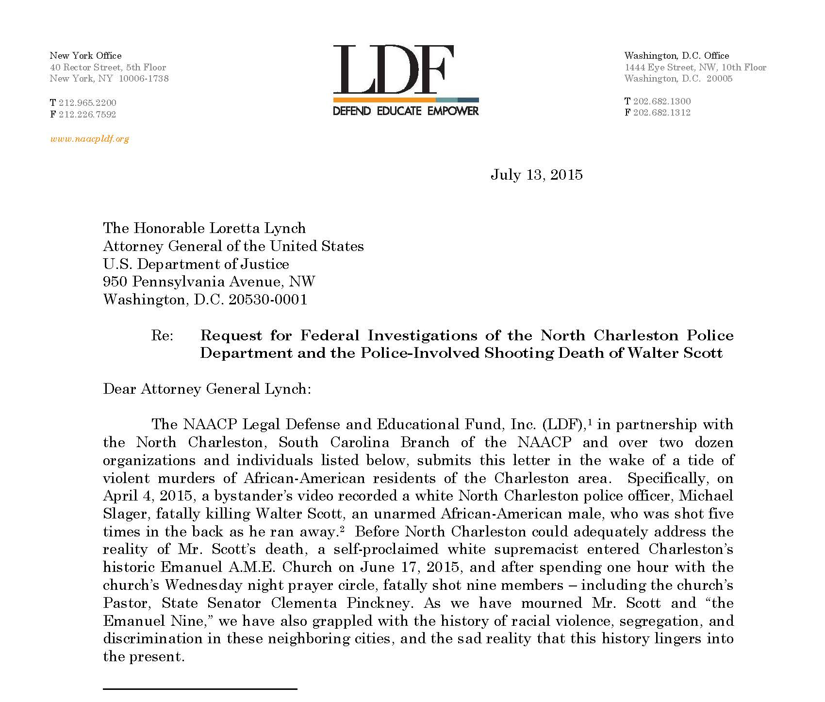
Along with 21 other organizations and 5 private citizens, we sent a letter to Attorney General Loretta Lynch requesting a Federal Investigation of the North Charleston Police Department and the police-involved shooting death of Walter Scott.

Slide 31
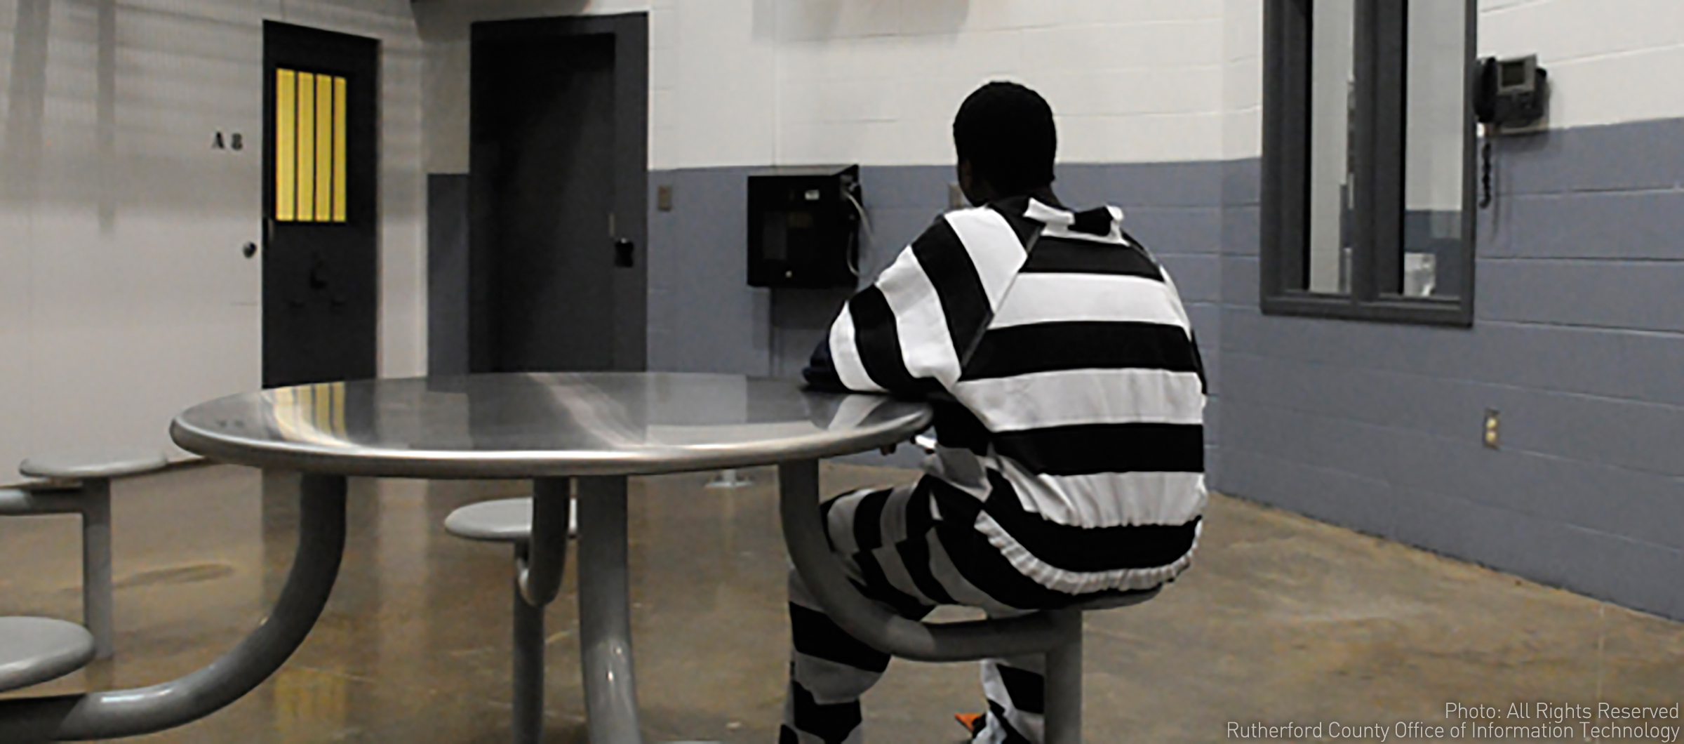
Youth Justice Advocacy

Slide 32
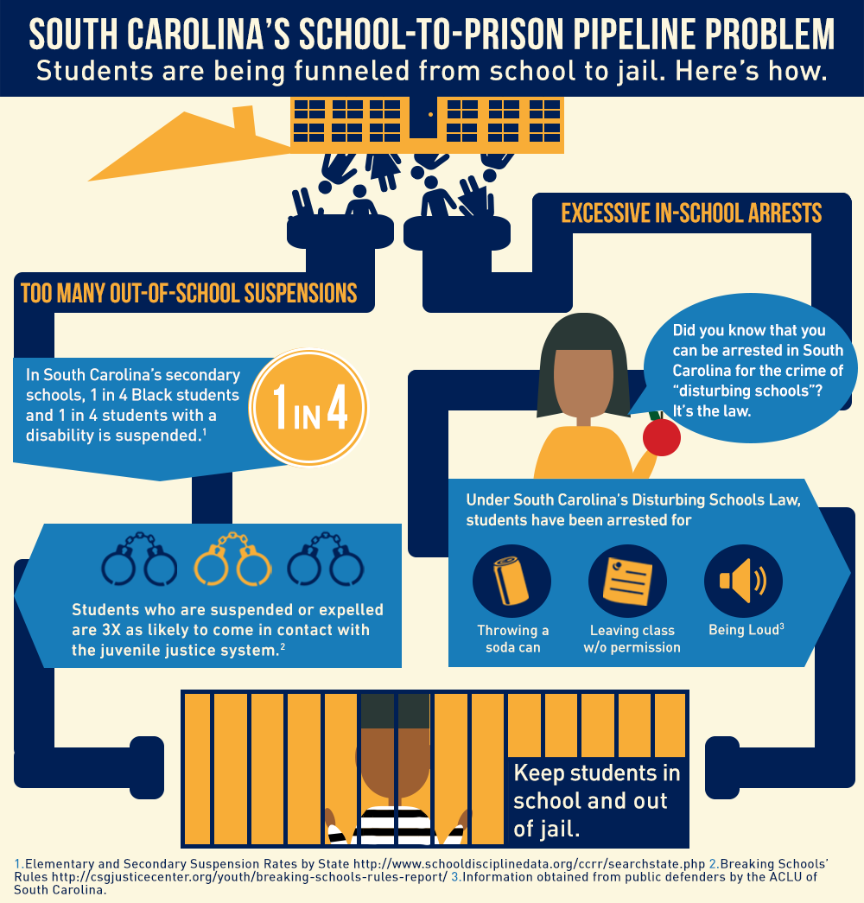

Slide 33
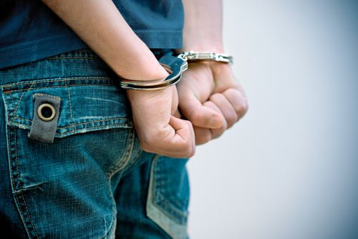
Juvenile Justice
From the Department of Juvenile Justice in 2013 (the last year statistics are available):
16,429 youth were referred to Family Court
1,282 – serious or violent crimes
1,364 – committed for long-term sentences
1,243 – sent to residential evaluation centers for up to 45 days
GIVE KIDS A CHANCE coalition is working to limit the number of residential evaluations and to reduce the detention of any youth who are status offenders.
During the current legislative session, GKAC will advocate for a change in the “disturbing schools” statute.

Slide 34
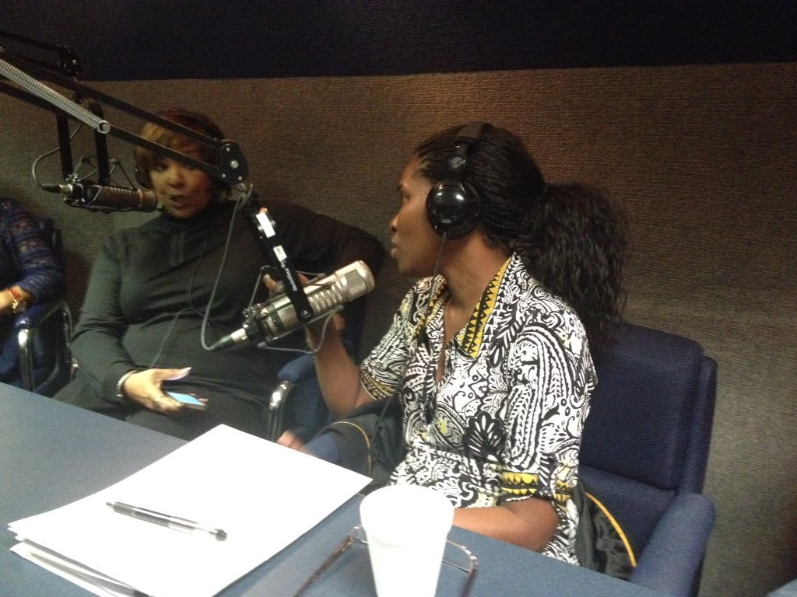
Give Kids a Chance
Our Youth Justice Advocate, Tracey Tucker, talking with radio show host Cynthia Hardy about the School-to-Prison Pipeline, The “Give Kids A Chance” Coalition, and the Disturbing Schools statute.
November 14, 2015

Slide 35
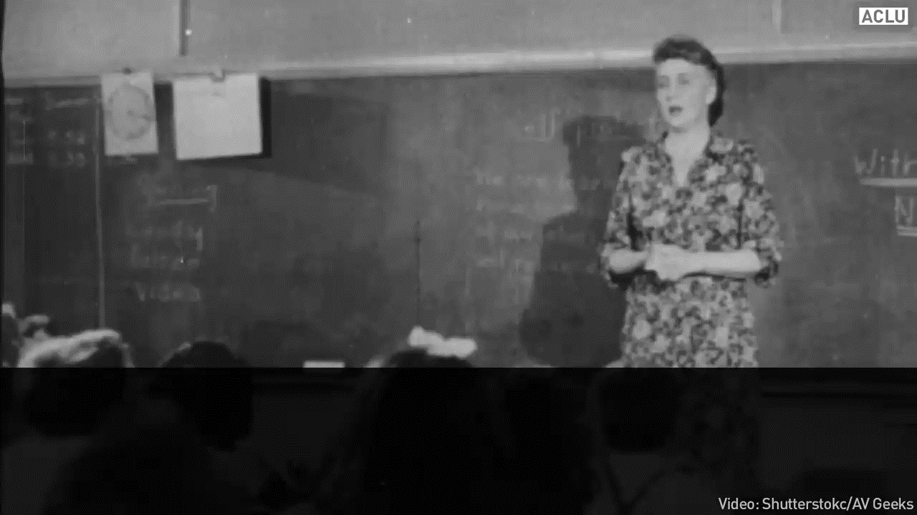
Disturbing schools
We continue to lobby for the repeal of “disturbing schools,” the segregation-era zero tolerance law that over-criminalizes youthful misbehavior.

Slide 36
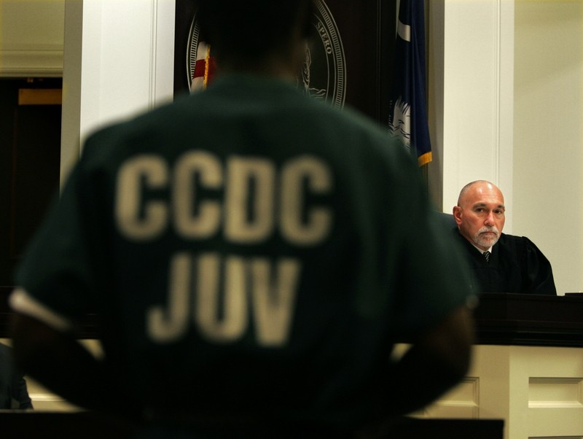
We supported Act 22 – Expungement of Juvenile Records
Many young offenders avoid further contact with the law after their first arrests, but records of those early crimes can haunt them later in life if steps aren't taken to ensure those documents remained sealed or are destroyed.
Act 22, as enacted into law and upon application after satisfaction of any imposed sentence or other punishment, a non-violent juvenile offender or status offender can have his or her record expunged.

Slide 37
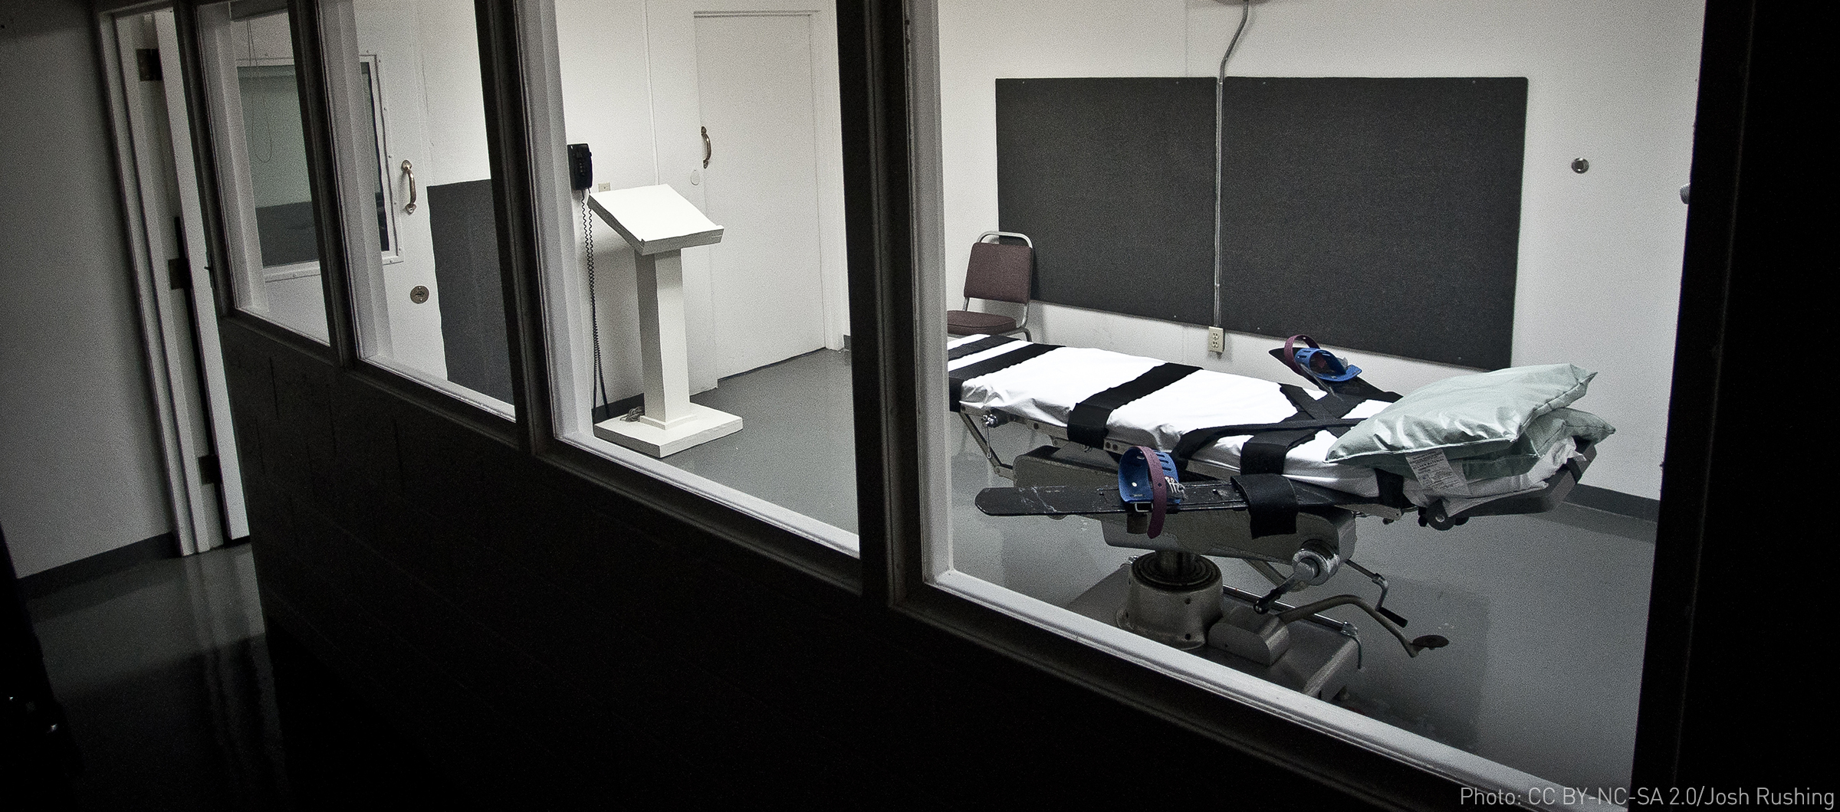
Death penalty

Slide 38
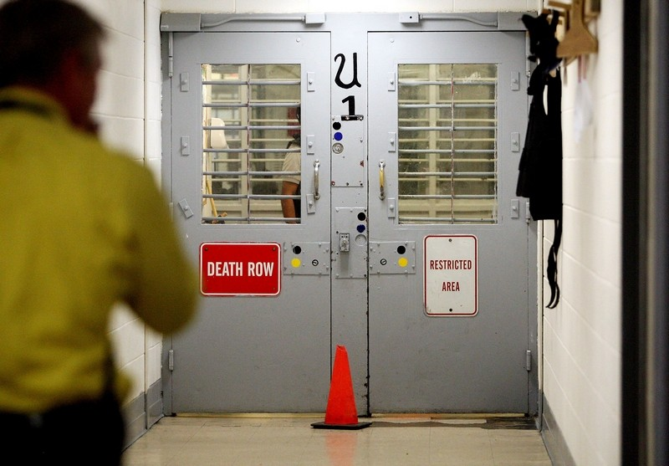
Death Penalty
South Carolina’s supply of the lethal injection drug cocktail expired in 2013, and the state has been looking for alternatives. H. 3853 attempts to keep any new developments secret from the public, and even the defendant.
Experimental cocktails have notoriously resulted in horrifically botched executions in Oklahoma, Arizona, Ohio & South Dakota.
Keeping the contents of the syringe secret is a violation of the 8th Amendment protecting against Cruel & Unusual Punishment.
Death row at Lieber Correctional Institution in Dorchester County, SC.

Slide 39
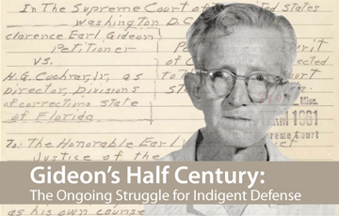
Indigent Defense

Slide 40
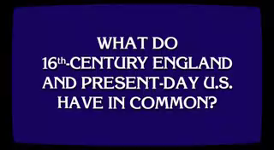
Child support
Can’t pay child support? Go directly to jail!
This practice is in direct contrast to a US Supreme Court ruling that if a parent does not have the ability to pay child support, they cannot be jailed.
We are working with allies across the state to ensure this rule is followed.

Slide 41
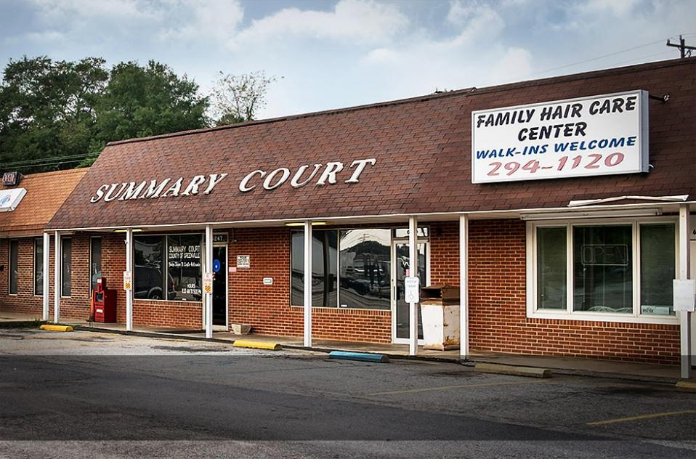
Indigent defense
Indigent defendants in South Carolina’s 212 municipal courts routinely plead guilty to minor charges without understanding – sometimes without even being informed of – their right to legal counsel, free of charge.
ACLU of SC, National ACLU and the National Association of Criminal Defense Attorneys are developing a state-wide strategy of advocacy & litigation.

Slide 42
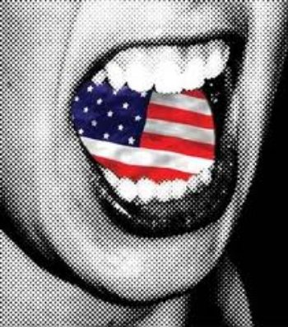
Voting Rights

Slide 43
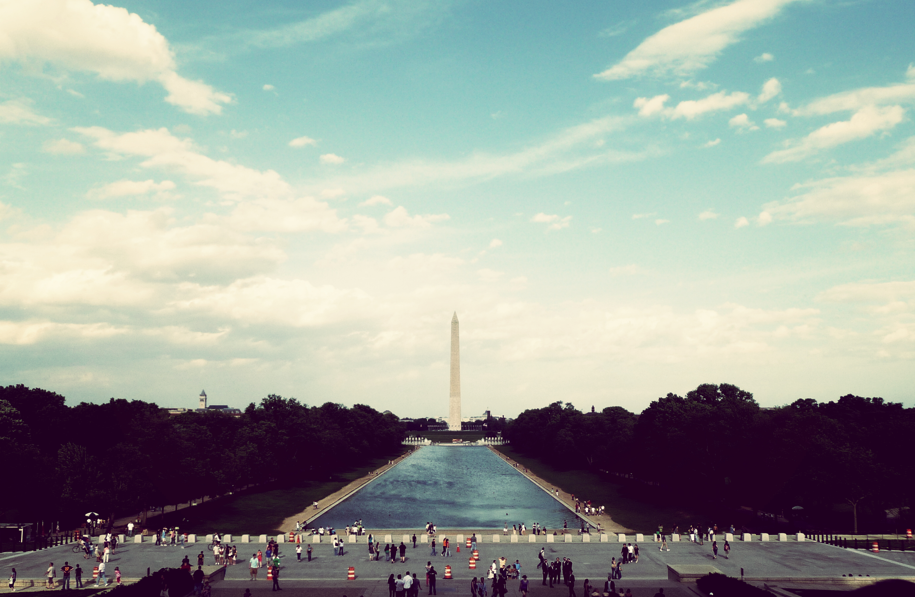
Protect the right to vote
“Our right to vote is the one constitutional right that guarantees all others.
In a huge blow to democracy, the U.S. Supreme Court struck down the coverage formula used in Section 4 of the Voting Rights Act.
We call on Congress, voting rights advocates and local government officials to do all in their power to protect our democracy and the right to vote.”
There are no election do-overs.
ACLU of SC and The League of Women Voters
Letter to the Editor
Charleston Post and Courier

Slide 44
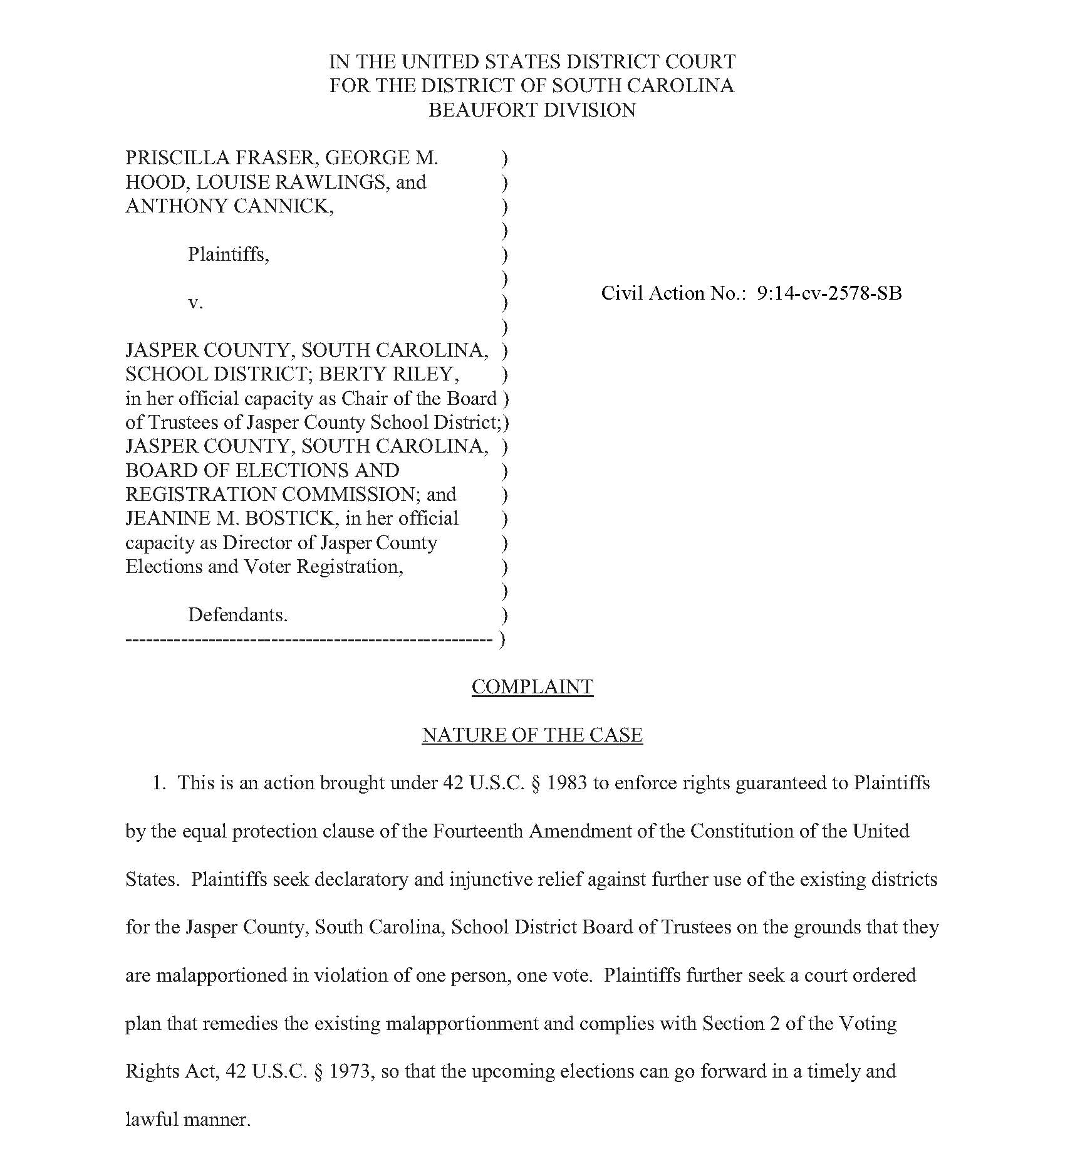
Jasper County School Board
Jasper County School District Board of Trustees’ nine single-member districts – last updated more than 15 years ago – violated the “one person, one vote” standard of the 14th Amendment.

Slide 45
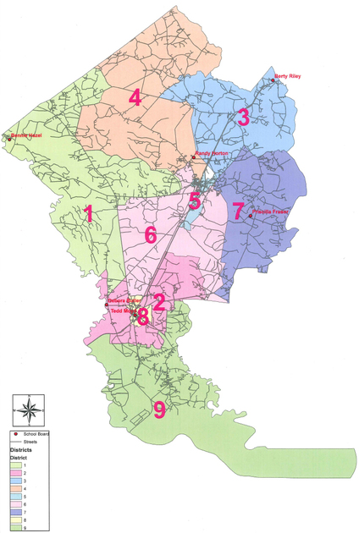
Jasper County School Board
Judge Gergel suspended November elections, and after reviewing 3 remedial plans the Court adopted one favorable to all parties.

Slide 46

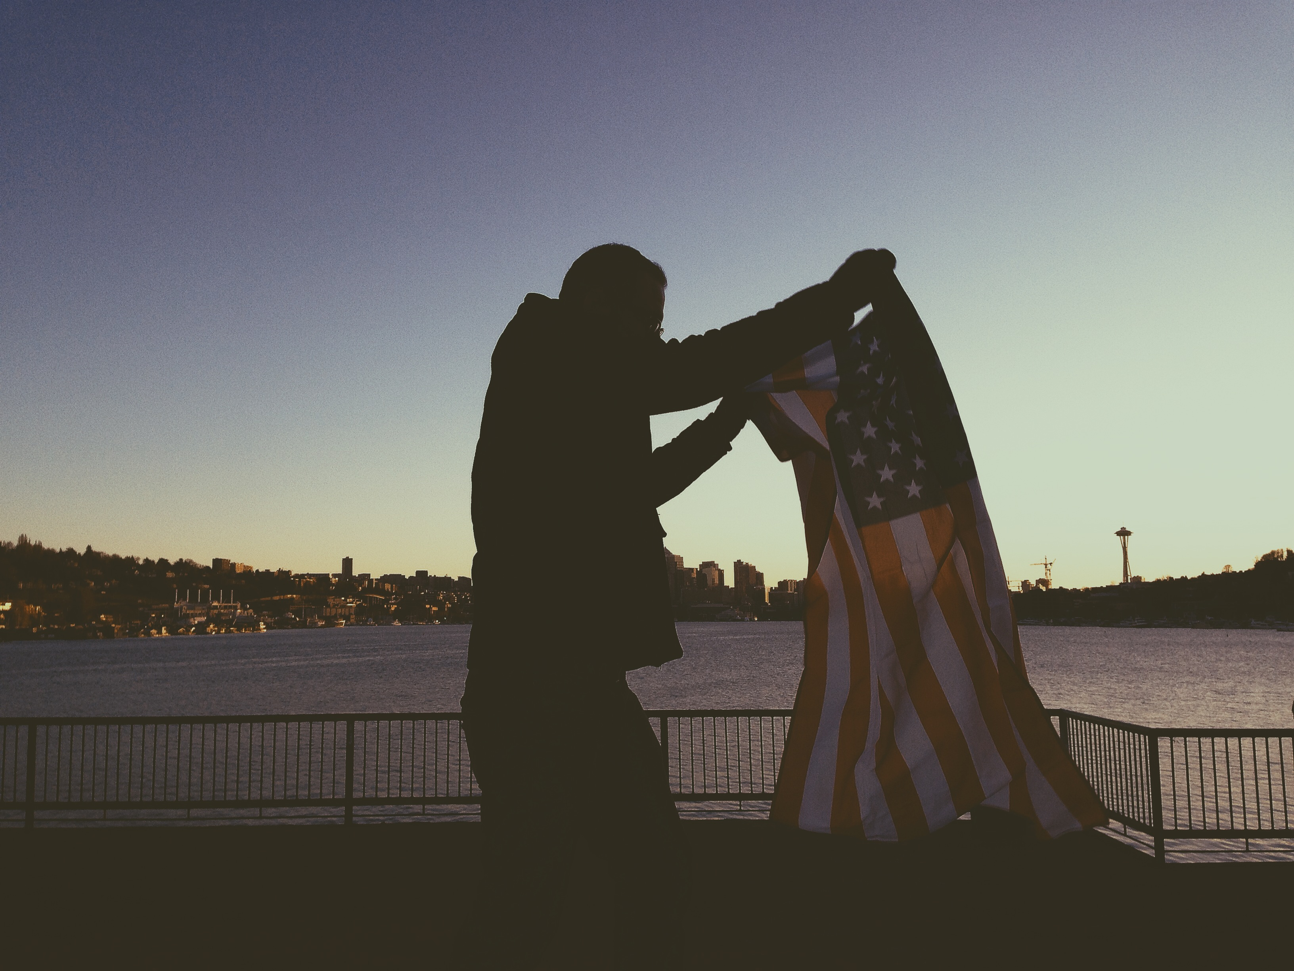
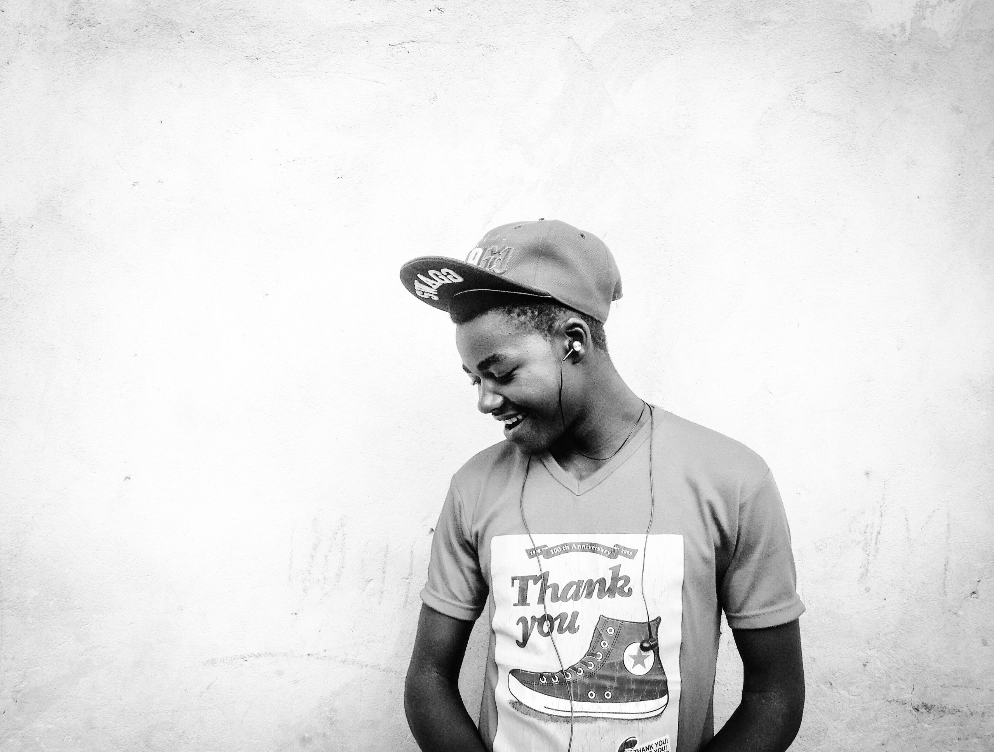
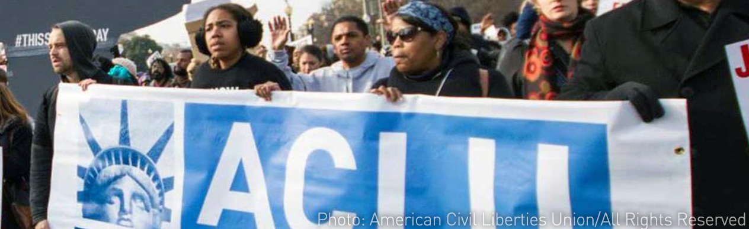
None of this would be possible
without the incredible support of our volunteers & members!
We are truly grateful for your dedication,
and together, we will continue to fight for our civil liberties in
South Carolina!

Slide 47
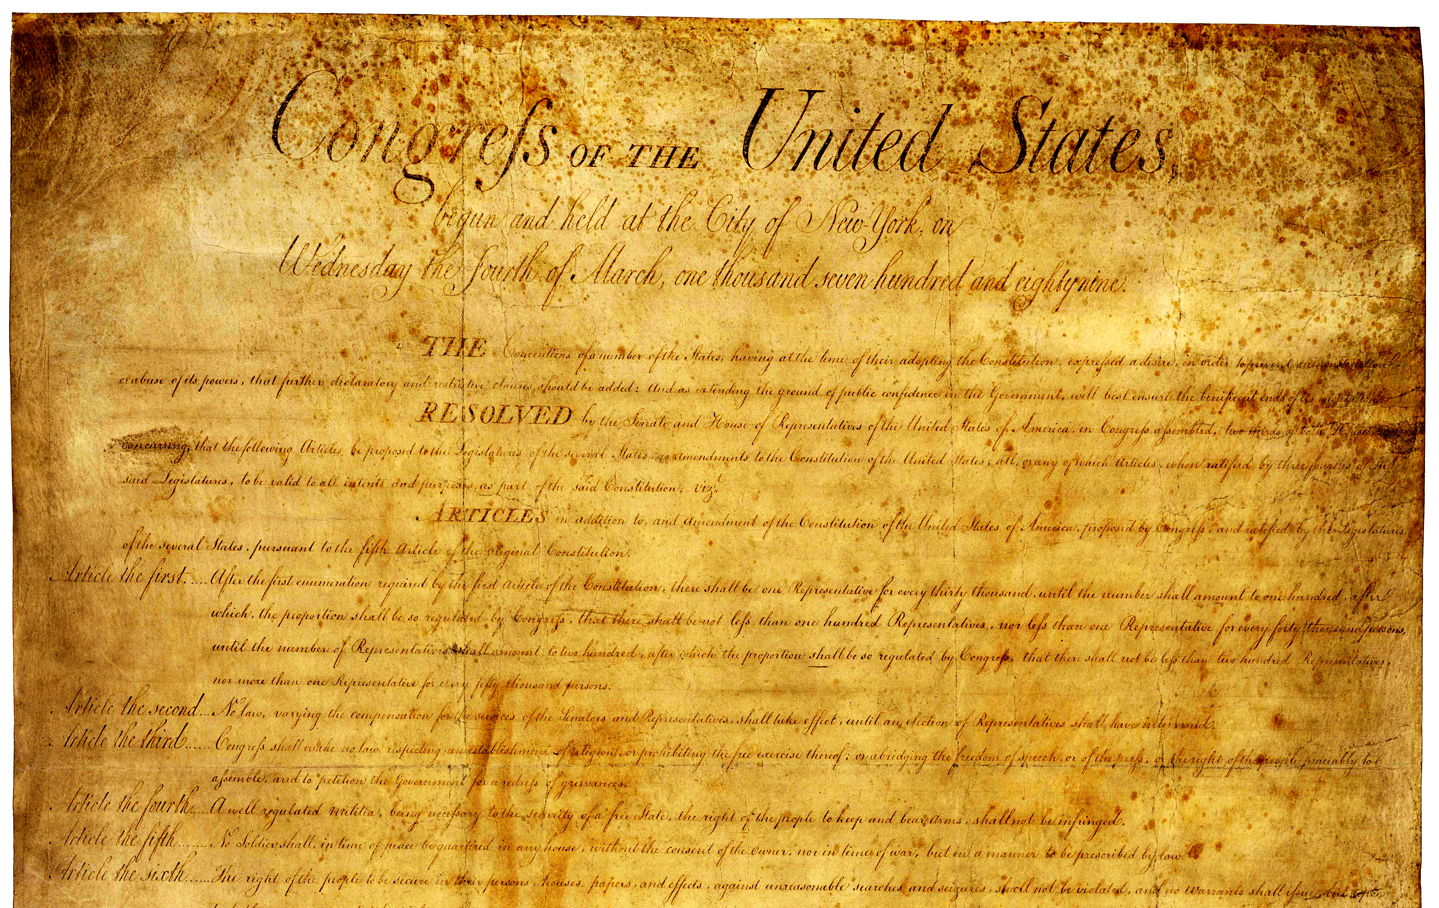
The
ACLU of South Carolina
is for the
100%

